Slide 1
Scene Recognition
Comparison of classification techniques
Machine Learning Mini Project
Course Instructor : Dr P Viswanath
By
Pranav Deep. I
S20201010007

Slide 2
Classification Techniques
What is Classification?
Classification refers to a predictive modeling problem where a class label is predicted for a given example of input data.
Predicts the output as a discrete value(usually called class label)
Popular Examples :
Logistic Regression
k-Nearest Neighbors
Decision Trees
Support Vector Machine
Naive Bayes

Slide 3
Classification Techniques
Types of Classification Techniques:
Binary Classification : Prediction o/p : 0 or 1 only
Multi-Class Classification : Prediction o/p varies from 0 to k where k is the no. of class labels
Multi-Label Classification : Each data sample can be predicted in more than one ways
Imbalanced Classification : Typical case of binary classification technique where most of the samples belong to only 1 data set
Eg : Fraud detection, Spam Detection, Medical Diagnosis etc

Slide 4
Classification Techniques Used:
Logistic Regression
Support Vector Machine
Neural Networks
Supervised Learning
Classification algorithm
Works well with linearly separable data
Uses sigmoid function to classify into a class
Uses Linear Regression Technique to find regression line
Supervised Learning
Classification algorithm
Uses support vectors to find the best separation b/w classes
Uses the concept of “Maximum Margin” to find this separation
Linear Classifier technique
Feed forward Artificial Neural network
Uses multiple layers of perceptron with hidden layers to build a model
Can distinguish data that is non-linearly separable
Uses the concept of activate function to determine each neuron’s o/p.

Slide 5
Data Sets Used
Scene -15
MNIST Fashion
Collection of 15 Scene Images like bedroom, factory, beach, buildings, roads etc.
Also contains a few objects in the data that can be helpful in object detection
Total size = 4485 Training set = 4023 Testing set = 462 Size resized to (224,224)
Dataset : Total Size: 60,000 Test size : 10,000 Size: 28x28 (grayscale images) Classes: 10 Labels include: T-shirt/top, trouser, pullover, dress, coat, sandal, shirt etc

Slide 6
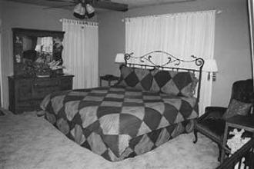
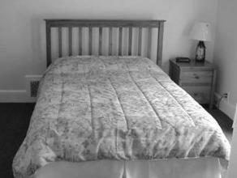
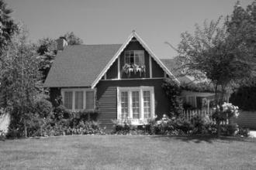
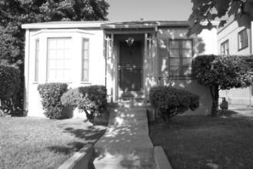
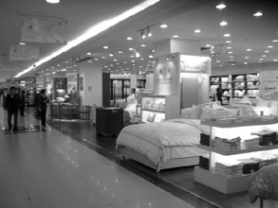
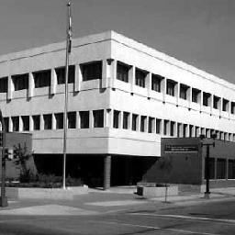
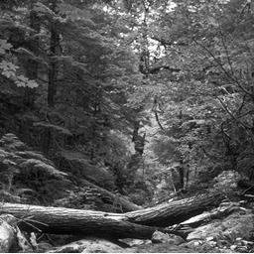
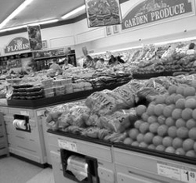
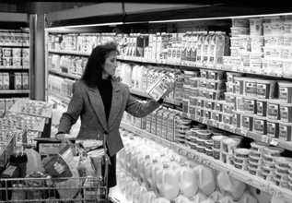
Data Samples
Scene-15 Data set

Slide 7
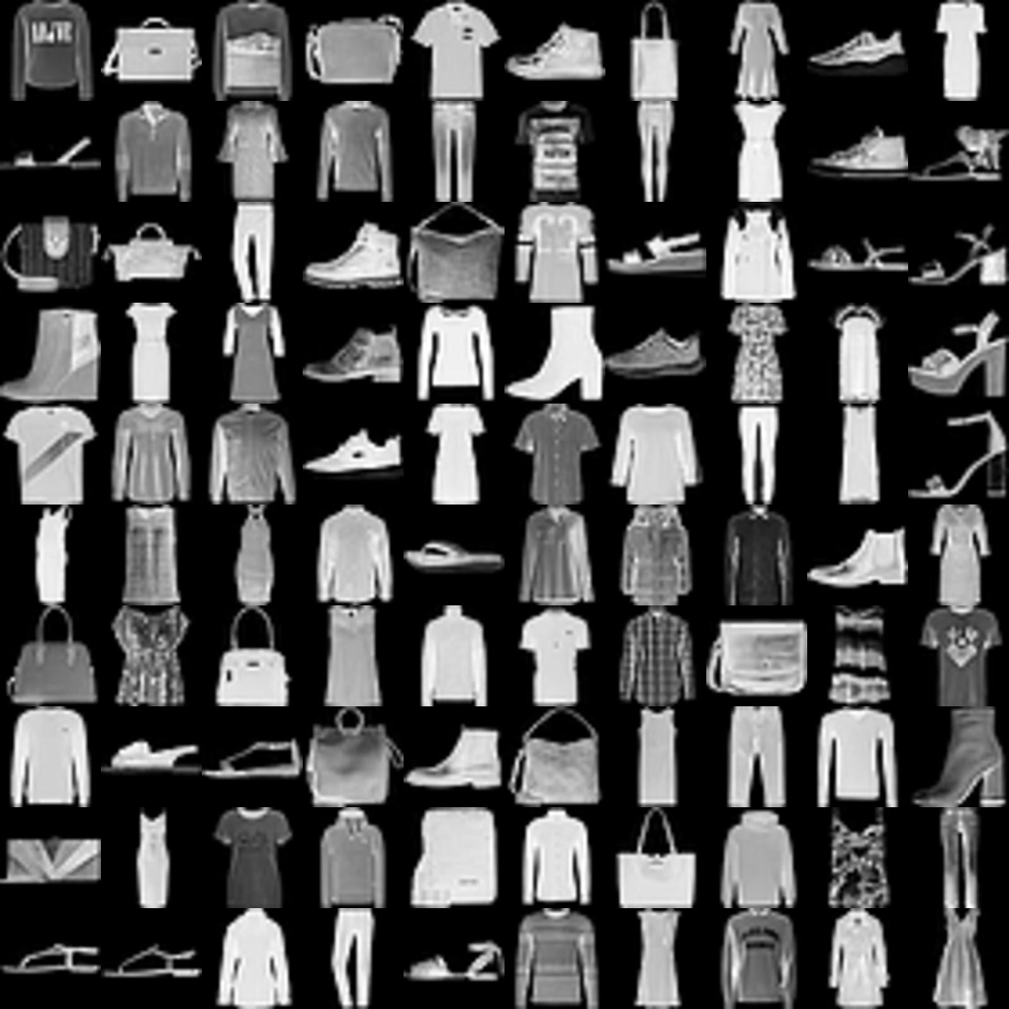
Data Samples
MNIST Fashion Data Set

Slide 8
Experiments
My experiments started with PCA as each of my data sample is sized (224,224)
PCA:
PCA is a dimensionality-reduction method that is often used to reduce the dimensionality of large data sets.
Steps:
Mean Subtraction
Covariance Matrix computation
Computation of Eigenvalues, Vectors
Reconstruct with x no. of principal components

Slide 9
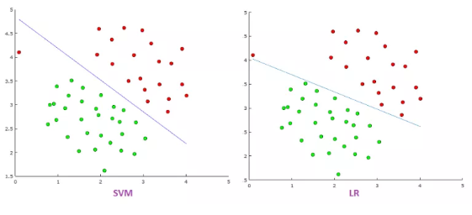
SVM vs Logistic Regression

Slide 10
SVM vs Logistic Regression
SVM tries to finds the “best” margin (distance between the line and the support vectors) that separates the classes and this reduces the risk of error on the data, while logistic regression does not, instead it can have different decision boundaries with different weights that are near the optimal point.
The risk of overfitting is less in SVM, while Logistic regression is vulnerable to overfitting.
SVM works well with unstructured, semi structured while logistic regression works with already identified independent variables.
Logistic Regression can be considered as a single perceptron Neural Network

Slide 11
Results
Data Set | Multinomial Logistic Regression (With PCA) | Multinomial Logistic Regression (w/o PCA) | SVM (with PCA) | SVM (w/o PCA) | Neural Network (ANN) | CNN
Scene - 15 | 50.32% | 53% | 31% | 36% | 47% | 86%
Fashion (MNIST) | 67% | 69.3% | 71% | 68.7% | 89% | -

Slide 12
Inference
Whether to choose Logistic or SVM completely depends on the size of n
If n is sufficiently large(~10,000): Logistic Regression will do better
If n is moderate(~1000) , SVM will do far better than other algorithms
In comparison, logistic regression lesser expensive computationally & lesser time consuming
SVM is lesser expensive computationally compared to N.Networks but takes lot more time
A.Neural Networks are most expensive computationally, but takes lesser time than SVM

Slide 13
Help Taken from:
Medium Website’s blog
Machine Learning Master Blog
Research Gate forum
Scikit Learn Documentation page
Tensor Flow CNN Example

